Slide 1
Joining an MS Teams Lesson
Using a SWASFT device (with & without Teams) & using a personal computer or device

Slide 2
Using MS Teams in SWASFT
Because Office 365 is still being configured in SWASFT, joining Teams meetings can be a bit tricky , as Outlook 2010, the Edge browser and MS Teams aren't made to communicate with each other.
Once everyone is moved to Teams and Office 365 this should all work. In the interim , we need a few work arounds!

Slide 3
Using MS Teams in SWASFT
Have the Teams App in SWASFT?
Join by clicking the button in Outlook invite as below

Slide 4
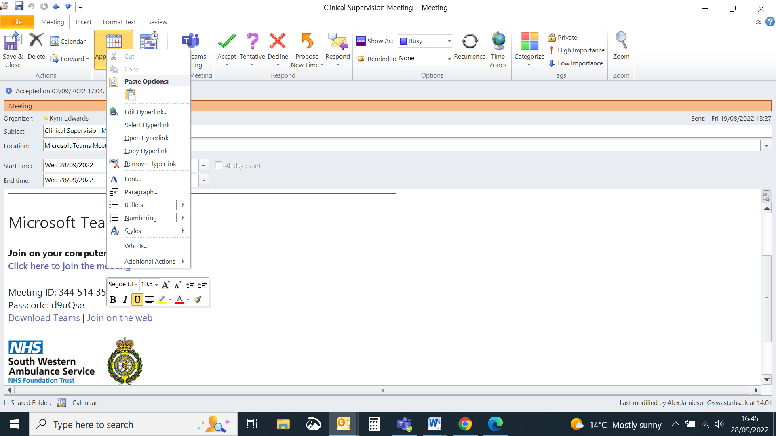
Using MS Teams in SWASFT
Don't have the app AND in SWASFT?
1.
You will need to cut & paste the meeting link
(R click the link> copy hyperlink)
And then open a private browser in edge.(See next slide)

Slide 5
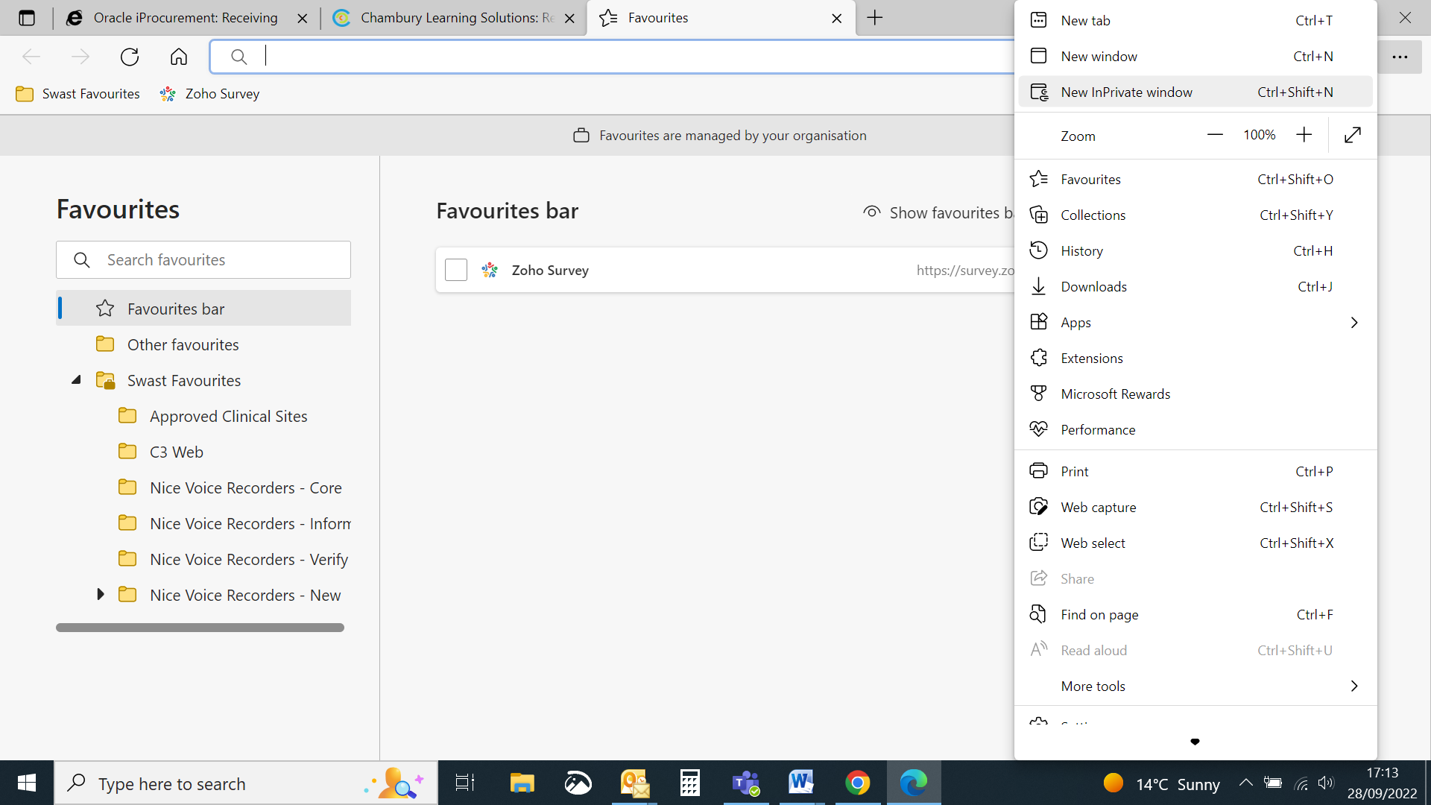
Using MS Teams in SWASFT
Don't have the app AND in SWASFT?
2.
Open a private browser tab (New InPrivate window) in edge.
3.
Then paste the link into this new window to join the meeting via browser.
(This stops the SWASFT systems being in conflict).

Slide 6
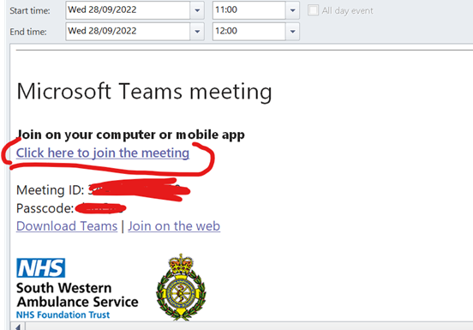
Joining a SWASFT MS Teams meeting using a non-SWASFT device
Just click on the link in your invite to join the meeting

