Slide 1

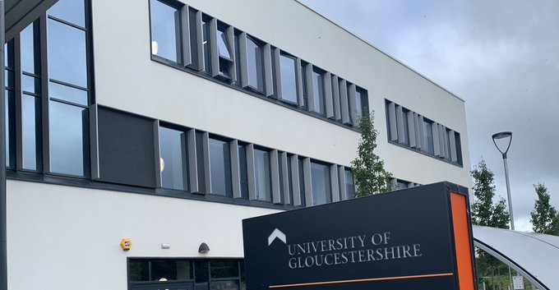
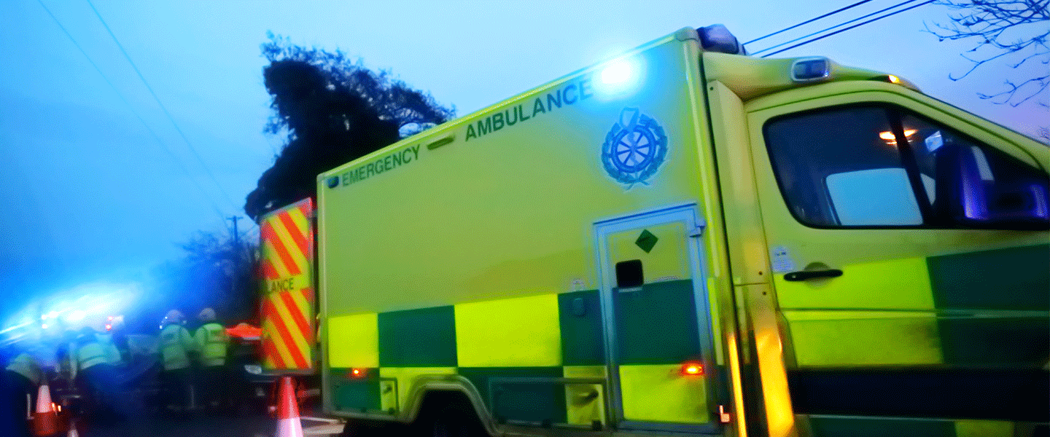
University of Gloucestershire Paramedic Science Practice Placement Guidance
Keith Bromwich
Senior Lecturer Paramedic Science Practice Educator Link

Slide 2


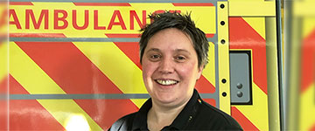
The team
Eve Scarle Academic Subject Lead E- Escarle@glos.ac.uk
Paramedics, Physiotherapy, Social Work, Radiography, ODP
Gemma Howlett Recruitment Lead and Academic Course Leader
E – Ghowlett@glos.ac.uk
Tech, Paramedic, Advanced paramedic, Education background
HCPC visiting team
Keith Bromwich Placement Lead E – Kbromwich@glos.ac.uk
Adult Nurse, Child Nurse, Paramedic, Emergency Care Practitioner, Education background
Advisor Baby Life Line -and teach on CEC course
Barry Matthews Paramedic and Senior Lecturer joins the team from 8 June
Matt Keith Gemma

Slide 3
Modules
Module Year 1 | CATs
To complete your programme you must pass the following compulsory modules:
PS4001: Foundations of Paramedic Practice | 30
PS4002: Evidence Based Practice 1 | 15
PS4003: Practice Education 1 | 30
PS4004: Foundations of Anatomy and Physiology to Support Clinical Practice | 30
PS4006: Skills and Simulation 1 | 15
Module Year 2 | CATs
To complete your programme you must pass the following compulsory modules:
PS5001: Pathophysiology for Paramedic Practice | 15
PS5002: Evidence Based Practice 2 | 15
PS5003: Practice Education 2 | 30
PS5004: Applied Pharmacology | 15
PS5005: Emergency Mental Health | 15
PS5006: Skills and Simulation 2 | 30
Module Year 3 | CATs
To complete your programme you must pass the following compulsory modules:
PS6001: Leading and Managing Service | 15
PS6002: Facilitating Learning in the Workplace | 15
PS6003: Practice Education 3 | 30
PS6004: Driving Change in Practice | 30
PS6005: Management of Trauma | 15
PS6006: Management of Minor Illness | 15

Slide 4
The cohorts Although we have hours attached to the course we are more concerned with capabilities. The allocation of hours assists in planning practice placements. Hours that are shown here are a guide to achieving a total of 1850 over 3 years
The first year is centred around developing key care and communication skills as well as introduction to ambulance practice
Placements are at Care Homes, Special Schools and Ambulance based
Year 1
Hours Ambulance 350 Non Ambulance 200 Simulation 55
Year 2
Hours Ambulance 450 Non Ambulance 200 Simulation 65
Year 3
Hours Ambulance 450 Non Ambulance 200 Simulation 55
Ambulance placement undertaking Needle skills and improving health assessments, Learning ECG 12 leads in depth Transforming from year 1 to paramedic over the year so more emphasis on paramedic practice and skills
Skill development Airway management and assessment skills including ventilation as well as ALS across the age range
This year is about exploring the urgent and non urgent side of pre hospital care as well as developing leadership skills
Time in urgent care, EOC, GP practice etc
Developing independence and getting ready to be the NQP

Slide 5

Capabilities Framework
The capabilities, developed by Dr Freeman-May (2012) seek to describe the components of paramedic practice that can and should be assessed.
This work discussed areas of capability aligned to the professional responsibility of paramedics and the requirements of the Health and Care Professionals Council (HCPC) Standards of Proficiency for Paramedics
Rather than a simple list of skills, they are designed to capture the essence of what it required to deliver competent and professional paramedic care.

Slide 6
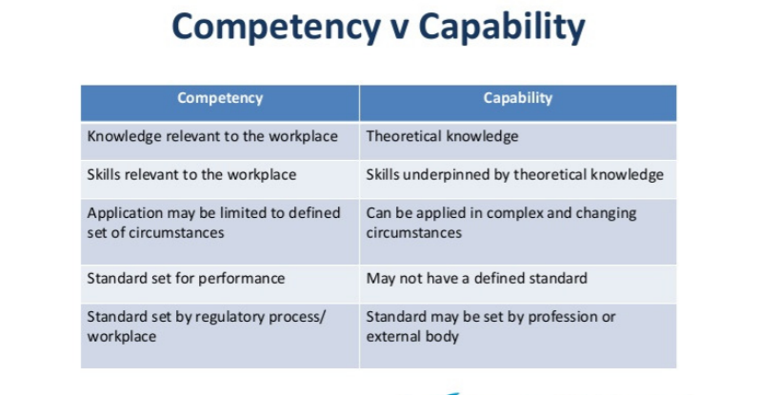
Competence V Capabilities
“Competence” as a word has its origins in 1632 from the French word “competence”, which means 'sufficient living in ease' and further in the Latin word “competentia”, which means agreement or symmetry. Useful to follow a guideline or protocol with out question
“Capability” came from the middle French Word 'capabilite' and late Latin word “capabili”. The first used in 1587. Capability is an integration of knowledge skills and personal qualities used effectively and appropriately in response to varied, familiar and unfamiliar circumstances and this is what we would like our students to achieve

Slide 7



Capabilities Framework
Managing People and Situations
Information Gathering
Planning and Organisation
Treating the Patient
Communicating
Learning through experience
Flexibility and resilience in response
Decision making and problem solving
Skills in Practice
Dr Andy freeman-May (2012)
Paramedic and Senior Lecturer Oxford Brookes University

Slide 8
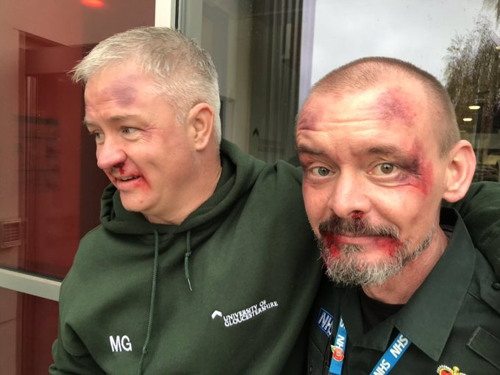
Capabilities Framework Level of Attainment
The expectations of students will, naturally, change from year to year.
In 1st year a demonstration of the capabilities whilst being supported is required.
In 2nd year students will need to have achieved the level of supported practice, with some evidence of independent practice
By the end of their final year (3rd year) it is expected that students will have demonstrated that they are able to independently, without guidance from practice educators, achieve all of the capabilities.

Slide 9
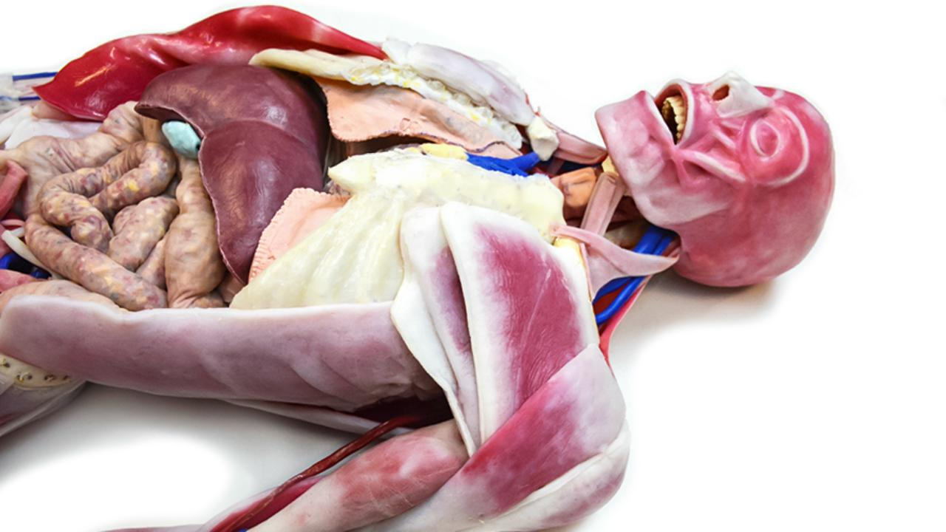
Capabilities Treating the Patient (Year 1 and 2)
Example year 1
Example Year 2
Basic treatments such as positioning, oxygenation and pain management as well as airway management need to be considered in this capability. The appropriate use of equipment, such as airway adjuncts, as well as medication should be in line with accepted guidelines.
At the end of second year students should be able to:
Demonstrate an understanding of paramedic treatment options
Deliver paramedic treatment under supervision
Manage advanced life support and react to critical changes in patient condition
Basic treatments such as positioning, oxygenation and pain management as well as airway management need to be considered in this capability. The appropriate use of equipment, such as airway adjuncts, as well as medication should be in line with accepted guidelines.
At the end of first year students should be able to:
Demonstrate and understanding of basic treatments
Deliver basic treatments under supervision
Manage basic life support and recognise critical treatment needs

Slide 10
Recording the evidence Evidence of attainment of the capabilities needs to be documented by utilising the reflective model template. The student reflects upon a skill or patient and decides which capabilities the reflection relates to As Practice educator you review the reflection add comments (and capabilities if you wish). You can also set future learning using this as a result of the reflection
Rolfe et al (2001)
What?
should describe briefly the issue at hand or problem encountered.
So What?
provides a space for students to go deeper into the meaning of the event and dis-cuss opportunities for change
What Now ?
describes the consequences or change in practice that results for this new understanding.
Practice educators will need to work with students so that they are realistic about their strengths and limitations.
When student reflection and practice educator feedback is combined the resultant document is submitted as evidence of learning.
This Reflection Provides Evidence For The following Capabilities (Circle all that apply) | Managing People and Situations Communicating Treating the Patient Flexibility and resilience in response Planning and Organisation Decision making and problem solving Learning through experience Information Gathering
Student Name
What
So What
What Now
Practice Educator comments
Practice Educator Signature
Circle relevant capabilities

Slide 11
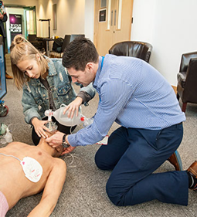
Skills Profile p34- 41
Green – Must complete
Orange – Can complete
Red – Must not complete
Sign off 1,2 or 3 times plus final sign off p41
Can monitor unsuccessful attempts
We use a stage approach related to skills module learning
You can sign a skill of once or multiple times if the student needs more practice in this skill

Slide 12
Initial Midway and Final Review Points
END YEAR SIGN OFF p60….
To say the student has
Initial p29- completed in first 2 weeks and sets the learning
Midway p30 complete week 6/7
Final p31 Last week
For each the student should present a SWOT analysis for discussion
All boxes need completing student should complete theirs first and then both meet to complete
Completed learning and development in practice
They have attended the shifts they are claiming
There are no action plans left unresolved
They have achieved all GREEN sections of the Skills
The PAD is then countersigned in University

Slide 13
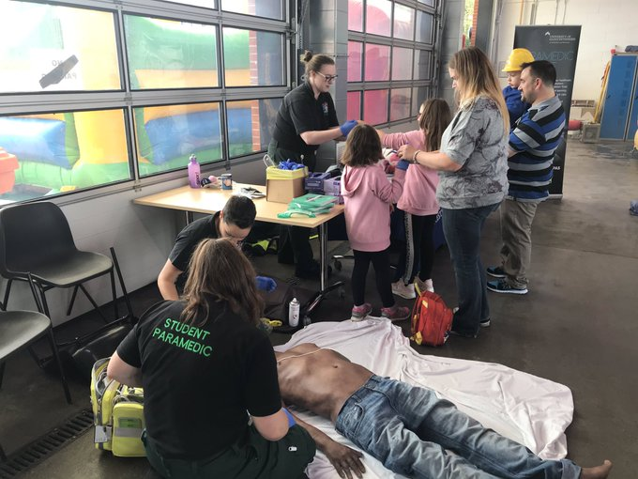
ACTION PLAN p53 You can place the student on an action plan or student can ask to place themselves on an action plan !
Why?
MUST use a Tri Party approach
Failing Student
Struggling with one area of practice e.g. BP recording
Not able to do something following support- not progressing
Concern around practice
Concern around professional behaviour
Concern other
Yourself
The student
University academic
Allows Practice and University resources to be deployed jointly to support and develop the student
Should be reviewed every 2 weeks

Slide 14
Airway and ventilation p54
Start good habits in documenting any airway assessment, support or intervention. Student responsibility to discuss / document and link to capabilities

Slide 15
Medications Student should build a portfolio of evidence
JRCALC
Patient medications
Student should be learning JRCAL medications as a minimum
They should also explore what the medications are for, when to use them, when not to use, the side effects, the interactions, and any contraindications
Long journey over 3 years to achieve this
Similar to JRCAL medication learning
Student lead this to give an understanding of common patient medications they encounter

Slide 16
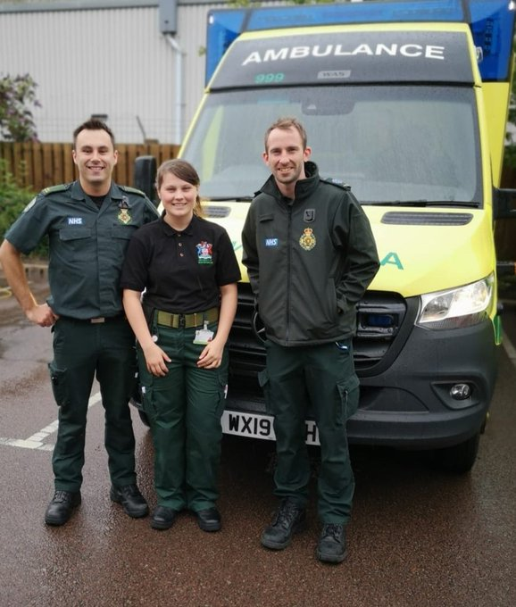
EPRF
If able to provide an anonymised copy
E-prf / ECGs but must confirm it is totally anonymised
EPRF should be relevant to their learning development and reflection
Can not use any photo
patients,
accident scenes,
Non anonymised documents

Slide 17
THANK YOU !
We value you
Got something to say?
A Huge thank you for supporting the student in practice
We value your thoughts and feedback
Feel free to contact us at the University or drop in anytime for a chat
Help drive and develop the course

Slide 18
